Slide 1

Software Engineering
Software Project Management, Architecture & Design
Software Project Management
Department of Computer Science and Engineering
Acknowledgement: Dr. Phalachandra HL, Prof. Anand MS, authors of the prescribed textbooks and materials sourced online.

Slide 2



Comparison
Consider a telephone used in the earlier days and a telecommunication application such as Skype
What are the characteristics and architectures of these two?
CENTRALIZED ARCHITECTURE PEER – TO – PEER ARCHITECTURE
Central office hardware (PSTN switch)
Benefits:
• Works through power outage
• Reliability
Peer to peer
Benefits:
• Scales without changes
• Features can be added easily

Slide 3

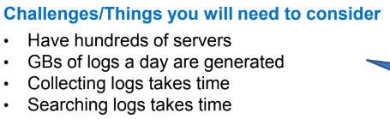
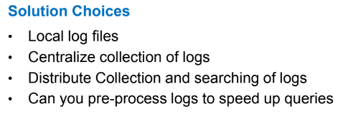
Think about it!
You are a service provider offering mail service
• Customers call in with their problems
• You need to review mail server logs to diagnose their problems
What are the challenges and the solution choices?

Slide 4
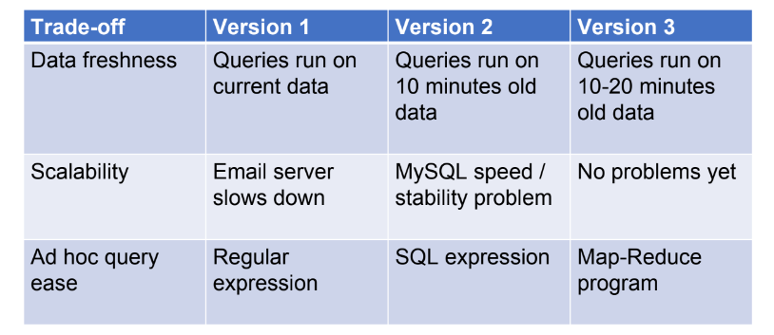
Quality attribute trade – off

Slide 5
Architectural conflicts
Using large-grain components improves performance but reduces maintainability
Introducing redundant data improves availability but makes security / data integrity more difficult
(Recall normalization and de – normalization in DB)
Localizing safety-related features usually means more communication so degraded performance

Slide 6
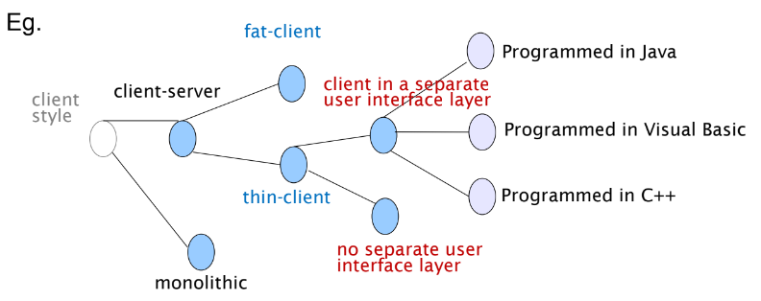
Design issues and decisions
Designer makes a design decision to resolve design issues faced
Design decision: Process involves choosing the best option from among the alternatives

Slide 7
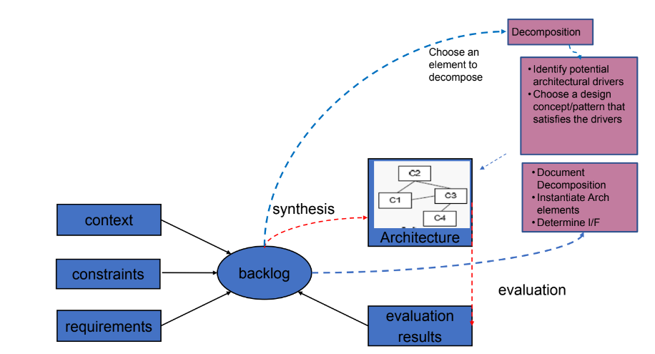
Generalized model for architecting
Understand problem
Solve it
Evaluate solution

Slide 8
Theme of architecture - Decomposition
The first step typically would involve decomposition of the problem to individual Modules (a set of code or data units)
Decomposition based on Layering
Approaches for decomposition
Configuration
Decomposition based on Distribution of computational resources
Decomposition based on Volatility
Decomposition based on Exposure
Decomposition based on Generality
Decomposition based on Functionality
Keep things together (Coupling) that work together (Cohesion)
Look for low coupling and high cohesion

Slide 9
Theme of architecture - Decomposition
Other ways of looking at approaches for decomposition include
Divide & Conquer
Stepwise Refinement
Top Down approach
Bottom Up approach
Information Hiding

Slide 10
THANK YOU
Software Project Management
Department of Computer Science and Engineering
‹#›

